Slide 1

ECEN 461
Real-Time and Embedded Systems
IOT – Information – Example

Slide 2
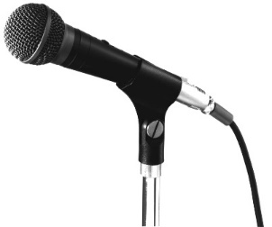
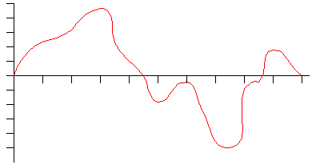
DSP Example
The Signal In
What determines the peak voltages?
What determines the maximum and minimum frequencies?

Slide 3
DSP Example
The Signal In
What determines the peak voltages?
Voltage out of the microphone. - 1 Volt Max.
What determines the maximum and minimum frequencies?
Audio Frequencies – 50 Hz to 20000 Hz.

Slide 4
DSP Example
The Signal In
A[n] = [23, 28, 32, 33, ……]
Sampling the Signal –
Sample Rate – How many samples per second?
A/D Resolution – How many buckets/sample?

Slide 5
DSP Example
The Signal In
A[n] = [23, 28, 32, 33, ……]
Sampling the Signal – Sample Rate
How often should we sample? – The simple answer is at least twice the maximum frequency – Nyquist rate – so in the case we would want to sample at 40000 Hz.
How many samples for a 10 second signal?

Slide 6
DSP Example
The Signal In
A[n] = [23, 28, 32, 33, ……]
Sampling the Signal – A/D Resolution – How many buckets/sample? The values are integers, we don’t have infinite resolution.
If we have an 8 bit ADC – What round off error might this cause?

Slide 7
DSP Example
1 volt
.0078 volts/bucket
Next bucket up
Next bucket down
256 buckets
-1 volt
Sampling the Signal – A/D Resolution – 8 A/D bits has 2⁸ buckets = 256
Each bucket is 2 Volts/256-1 = .0078 volts – The rounding error, up or down, max is ½ of this.
This is called quantization error – Round off error.

Slide 8
DSP Example
3
1 volt
Next bucket up
.666 volts/bucket
Next bucket down
2
4 buckets
1
0
-1 volt
An extreme example - Sampling the Signal – A/D Resolution – 2 A/D bits has 2² buckets = 4
Each bucket is 2 Volts/3 = .5 volts – The rounding error, up or down, max is ½ of this.
This is called quantization error – Round off error.
Why not just use an A/D with 16 bits?

Slide 9
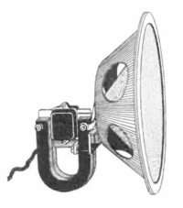
DSP Example
LPF
A/D
Our Digital System
A[n] = [23, 28, 32, 33, ……]
Signal Processing – What if we want to amplify the signal?

Slide 10
DSP Example
LPF
A/D
Our Digital System
A[n] = [23, 28, 32, 33, ……]
Signal Processing – What if we want to amplify the signal?
for (i = 0; i < array_size; i++)
A[i] = A[i] * 3.0;

Slide 11
DSP Example
LPF
A/D
Our Digital System
A[n] = [23, 28, 32, 33, ……]
Signal Processing – What if we want to mix (add) two signals?

Slide 12
DSP Example
LPF
A/D
Our Digital System
A[n] = [23, 28, 32, 33, ……]
Signal Processing – What if we want to mix (add) two signals?
for (i = 0; i < array_size; i++)
c[i] = a[i] + b[i];

Slide 13
DSP Example
LPF
A/D
Our Digital System
A[n] = [23, 28, 32, 33, ……]
Now the output – What if we wrote these values to a digital output?

Slide 14
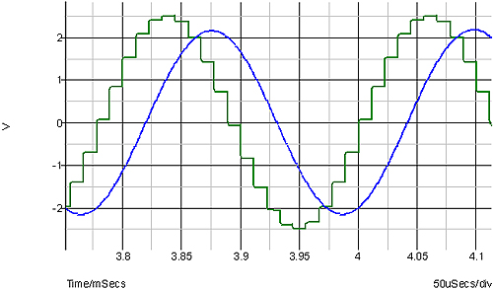
DSP Example
Our Digital System
A[n] = [23, 28, 32, 33, ……]

Slide 15
DSP Example
Our Digital System
LPF
A[n] = [23, 28, 32, 33, ……]

Slide 16
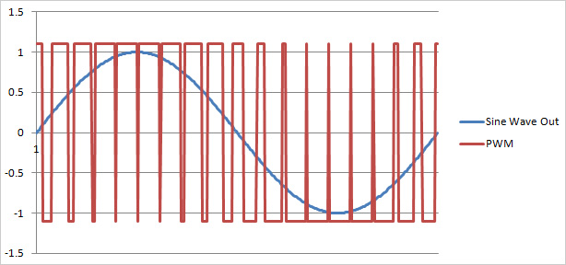
DSP Example
Our Digital System
LPF
A[n] = [23, 28, 32, 33, ……]
PWM as a D to A

Slide 17
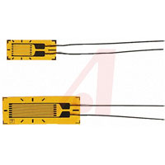
DSP Example
Example
Our Digital System
Furnace Switch
100 degrees – 1.5 volts
0 degrees – 0 volts
1000 Hz response rate
Input Temperature
If temp < 70.0 – Turn on furnace
If temp > 70.1 – Turn off furnace

Slide 18
DSP Example
Example
Our Digital System
Furnace Switch
100 degrees – 1.5 volts
0 degrees – 0 volts
1000 Hz response rate
What sample rate?
Input Temperature
If temp < 70.0 – Turn on furnace
If temp > 70.1 – Turn off furnace

Slide 19
DSP Example
Example
Our Digital System
Furnace Switch
100 degrees – 1.5 volts
0 degrees – 0 volts
1000 Hz response rate
What sample rate?
2000 Hz
Input Temperature
If temp < 70.0 – Turn on furnace
If temp > 70.1 – Turn off furnace

Slide 20
DSP Example
Example
Our Digital System
Furnace Switch
100 degrees – 1.5 volts
0 degrees – 0 volts
1000 Hz response rate
What sample rate?
2000 Hz
Input Temperature
If temp < 70.0 – Turn on furnace
If temp > 70.1 – Turn off furnace
What A/D resolution?

Slide 21
DSP Example
Example
Our Digital System
Furnace Switch
Input Temperature
If temp < 70.0 – Turn on furnace
If temp > 70.1 – Turn off furnace
What A/D resolution?
70.0 degrees = 1.05 volts
70.1 degrees = 1.0515 volts
We need 0.15 volts resolution
100 degrees – 1.5 volts
0 degrees – 0 volts
1000 Hz response rate
What sample rate?
2000 Hz

Slide 22
DSP Example
Example
Our Digital System
Furnace Switch
.015 volts/degree
1.5 volts max
.1 volts min
1000 Hz response rate
What sample rate?
2000 Hz
Input Temperature
If temp < 70.0 – Turn on furnace
If temp > 70.1 – Turn off furnace
What A/D resolution?
70.0 degrees = 1.05 volts
70.1 degrees = 1.0515 volts
We need 0.0015 volts resolution
(1.5 – 0)/0.0015 = number of buckets
At least 1000 buckets
8 bits = 2⁷ = 256 – not enough
9 bits = 2⁸ = 512 – not enough
10 bits = 2⁹ = 1024 - enough

Slide 23
DSP Example
What does the code look like?
Example
Our Digital System
Furnace Switch
.015 volts/degree
1.5 volts max
.1 volts min
1000 Hz response rate
What sample rate?
2000 Hz
Input Temperature
If temp < 70.0 – Turn on furnace
If temp > 70.1 – Turn off furnace
What A/D resolution?
70.0 degrees = 1.05 volts
70.1 degrees = 1.0515 volts
We need 0.0015 volts resolution
(1.5 – 0)/0.0015 = number of buckets
At least 1000 buckets
8 bits = 2⁷ = 256 – not enough
9 bits = 2⁸ = 512 – not enough
10 bits = 2⁹ = 1024 - enough

Slide 24
DSP Example
What does the code look like?
Calculating the temperature from the reading:
Temperature = (reading/number of bits) * full scale temp)
Full scale voltage = 1.5 volts
Full scale temp = 1.5/.015 = 100 degrees
Our Digital System
Furnace Switch
.015 volts/degree
1.5 volts max
.1 volts min
1000 Hz response rate
What sample rate?
2000 Hz
Input Temperature
If temp < 70.0 – Turn on furnace
If temp > 70.1 – Turn off furnace
What A/D resolution?
70.0 degrees = 1.05 volts
70.1 degrees = 1.0515 volts
We need 0.0015 volts resolution
(1.5 – 0)/0.0015 = number of buckets
At least 1000 buckets
8 bits = 2⁷ = 256 – not enough
9 bits = 2⁸ = 512 – not enough
10 bits = 2⁹ = 1024 - enough

Slide 25
DSP Example
What does the code look like?
Calculating the temperature from the reading:
Temperature = (reading/number of bits) * full scale temp)
Full scale voltage = 1.5 volts
Full scale temp = 1.5/.015 = 100 degrees
Our Digital System
Furnace Switch
Reading = 720
Temperature = 720/1024 * 100
Temperature = 70.3 degrees
.015 volts/degree
1.5 volts max
.1 volts min
1000 Hz response rate
What sample rate?
2000 Hz
Input Temperature
If temp < 70.0 – Turn on furnace
If temp > 70.1 – Turn off furnace
What A/D resolution?
70.0 degrees = 1.05 volts
70.1 degrees = 1.0515 volts
We need 0.0015 volts resolution
(1.5 – 0)/0.0015 = number of buckets
At least 1000 buckets
8 bits = 2⁷ = 256 – not enough
9 bits = 2⁸ = 512 – not enough
10 bits = 2⁹ = 1024 - enough

